Slide 1
Angular
GitHub versioning

Slide 2
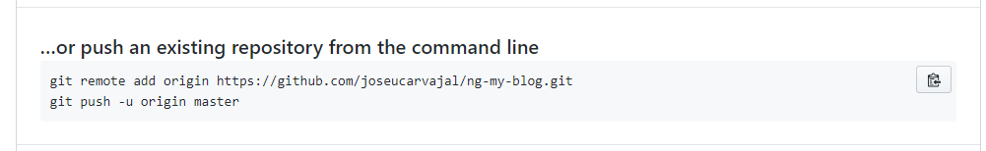
GitHub project versioning
Create GitHub: https://github.com/ account
Create new GitHub repository
Download and install git-cli for Windows: https://git-scm.com/downloads
Create new GitHub account
git config --global user.name “joseucarvajal"
git config --global user.email “joseucarvajal@gmail.com”
git config --global user.password “My-password"
Exec next commands in VS:

Slide 3
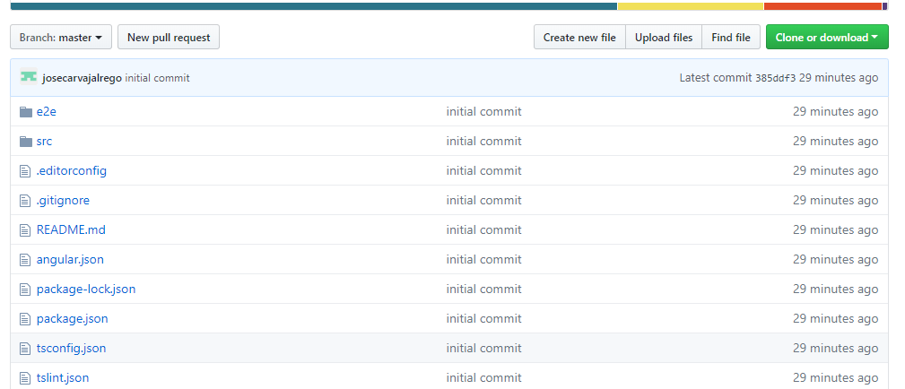
Verificar Proyecto en GitHub

